Slide 1
School Management System
By:
Dhanushya.G

Slide 2
CONTENTS:
ABSTRACT
INTRODUCTION
SYSTEM REQUIREMENTS
MODULES
SCREEN SHOTS
CONCLUSION

Slide 3
ABSTRACT:
The school management system is an application developed for schools. It is an application developed in Java which is used to store all the school-related records. It stores information related to students and teachers. The objective of developing such a system was to reduce the errors that creep in the manual system where it was very difficult to store the records. It also provides the facility to calculate the fees paid of the student. The whole system is handled by the administrator who has all the rights to edit or modify any school member information. This system was developed to provide a secure, easy to use a reliable system. This was created to handle all the school-related information and save it in records.

Slide 4
INTRODUCTION:
In the earlier system, it was difficult to store all the student and teacher records which required a lot of paperwork and time consumption. It also leads to errors and mistakes. Everything has to be marked manually. These systems also caused redundancy of data. If any records need to be updated then it has to be changed in every file so making it difficult to manage all the data. There was no security as anyone can view those records. So there was the need for developing an automated system which could handle all these problems making the system easier to use.

Slide 5
SYSTEM EQUIREMENTS:
Software Requirements
Operating System - Windows 10.
Platform – Eclipse IDE.
Language – Java.
Hardware Requirements
Hard Disk – 2 GB.
RAM required – 1 GB (minimum)
Processor – Dual Core or Above.

Slide 6
MODULES:
Student
Teacher
School
Main

Slide 7
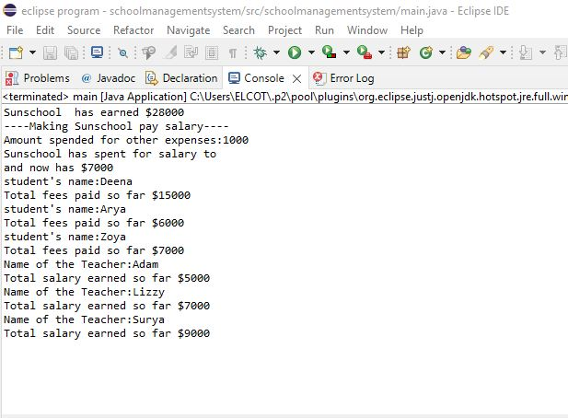
SCREEN SHOT:

Slide 8
CONCLUSION:
Now it is developed to solve all the problems that occurred in the earlier systems. It provides a user-friendly interface where there is an administrator which only has the privilege to access the data. This makes system secure and reliable. This system allows to keep track of the student's details and maintain all the staff information. So everything becomes easy thus reducing the risks that come with an earlier manual records.

Slide 9
THANK YOU

